Slide 1
Promotion Mix: NegEx Bayesian Model
Jan 22, 2009

Slide 2
Objective of Promo Mix -- help pharmaceutical firms overcome 3 challenges
How is the promotion outcome?
----→ promotion results quantity analysis.
2. In order to maximize revenue, which promotion channels I should use?
----→ optimal combination of promotion channels.
3. And how should I allocate my budget to each promotion channel?
--→ optimal resource allocation.

Slide 3
IMS helps our clients overcome their challenges around promotional allocation through an engagement that ultimately optimizes the marketing plan and increases brand profits
Understanding of effectiveness of past promotions
Insights into outcomes due to future promotion
Optimized spend and increased profits
IMS Health Commercial Effectiveness Consulting
Promotion Management
Client’s Promotional Allocation Issues
+
=
Promo Return
Promo Cast
Promo Mix

Slide 4
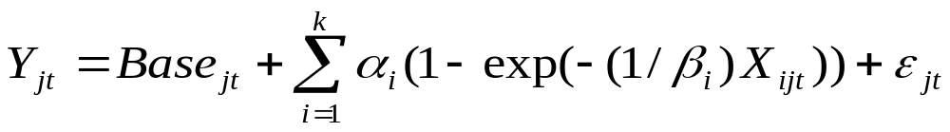

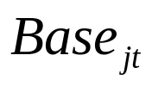
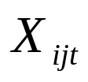


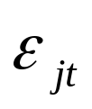
Negative Exponential Model
- is the dependent variable (NRxs, TRxs, or Sales, or etc.) of segment j at time t
- includes intercept(s), non-promotional factors such as trend, seasonality, competitors’ promotional activities, and market event(s), if any
- is the carry-over adjusted promotional channel , the number of promotional channels included in the analysis) of segment j at time t
- is the normally distributed error term of segment j at time t

Slide 5
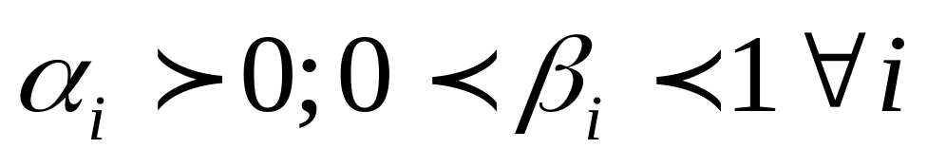
Nature of coefficient restrictions
Assume a positive impact of every channel on sales, and the impact are increasing at a decreasing rate. In other words, an increase of detail spend from zero to $1M will increase the sales by $200M. But when detail spend is increased from $1MM to $2M, the sales will increase by less than $200M.
These assumptions conform with basic theory and experiences.
These assumptions imply the following restrictions:
Alpha is the scale parameter and beta is the shape parameter.

Slide 6
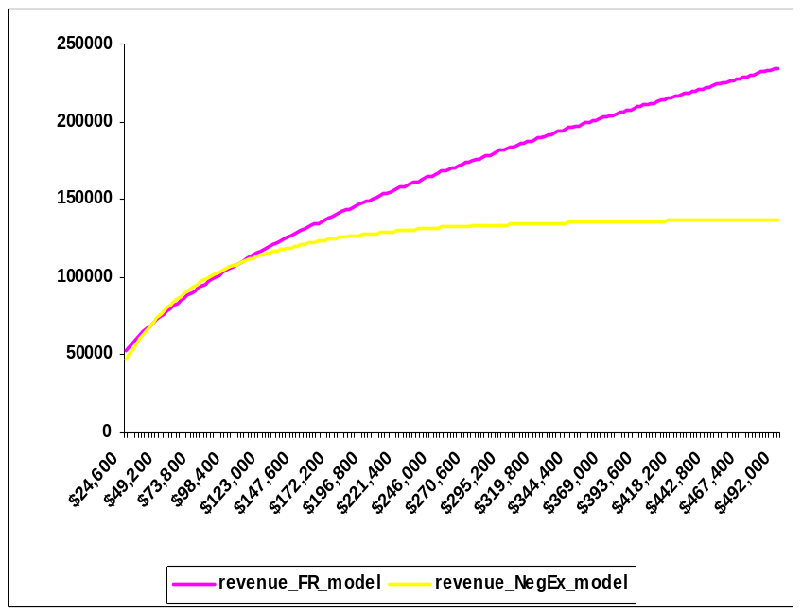
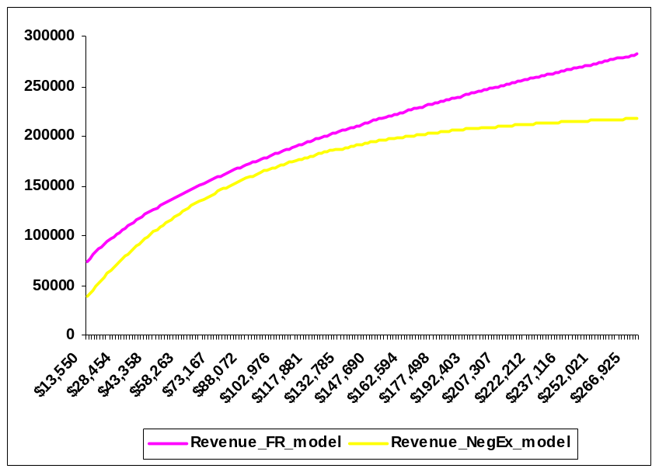
Beauty of Negative Exponential model
1.It offers more curvature response curves compare to fractional root model.
2. It is separable and the contributions can be calculated separately for each promotional channel compare to log-log model.

Slide 7
Model Data
Promotion activity and response data;
Non-promotion data;
Prior data.

Slide 8
Model Data
------Promotion activity and response data
The data is the basis of our understanding of the historical impact of promotion channels and therefore directly impacts the recommendations of the optimal promotion mix
  Consequently, quality data is paramount to the success of the project
  “Garbage-in, Garbage-Out”
We utilize IMS’ prescription databases, sales database and client sales data in order to measure the demand
  We run models at various levels including National, regional, and physician level.
We utilize both IMS and client promotional data
  Call data: Details and Samples
  DTC GRPs and Spend
  Journal Spend
  Meetings and Events
  Web Advertising
  Etc…

Slide 9
Model Data
------Size adjust Promotion activity and response data
When modeling at the sub-national level we adjust each variable by a metric which represents the size of each segment, e.x. population size in each region.
Size adjusting the variables allows for a more accurate detection of the differences across the regions by minimizing the differences in scale amongst the regions.
  The sub-national promotional and response variables are size adjusted by dividing the raw promotional data by the regional population size.
  Adjusted promo = Raw promo / Regional population
  The national promotional and response variables are not size adjusted because the promotional effort is the same across the different regions.
  Adjusted promo = Raw promo / 1

Slide 10
Model Data
------Promotion activity data stock
Promotion typically has carry-over effects beyond when the promotion takes place
The carry-over mechanism can affect brand performance in two ways:
Short-term
During the time of
the promotion
Incremental Rx
Longer-term
Delayed/lagged effect
Build awareness over time among physicians
Repeat Rx
Equity

Slide 11
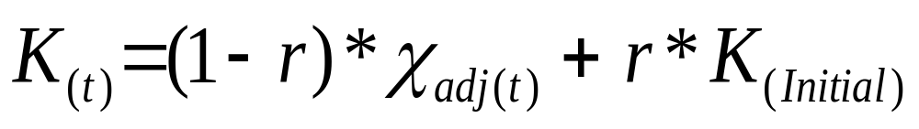
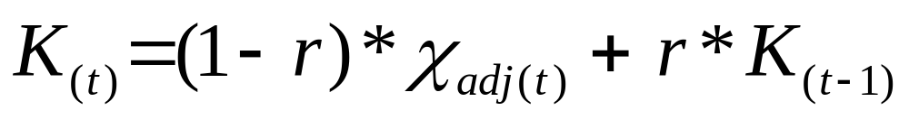
Model Data
------Promotion activity data stock
Creating an accurate starting stock is critical so that the modeled promotional series captures the actual trend in the historical promotional investment.
The initial stock value is set as the average of the first few months of the modeling data for each segment (The default is the first 3 months).
Finally, using the retention rate that we determined based on knowledge of the product/market and an iterative model fit analysis, we build the promo stock using the following algorithm:
If t = 1
If t > 1

Slide 12
Model Data
------Non-promotion data
Dummies or trends we defined in the baseline model for controlling the main market events or trends.
Goals of the Baseline Model
Understand major market events and trends, determine the appropriate coding and get an initial reasonable read on their impact
Generate reasonable reads on the top 1- 2 promo channels
Good model fit.

Slide 13
Model Data
------Prior data
Prior data are the prior promo contribution and data precision for each promo channel that we passed into the Bayesian model
Reason of using Bayesian model
the promo mix model has a set number of variables that must be included in the model and all promotions should yield a positive impact on sales. But usually the promo data has issues such as multicollinearity make it extremely difficult to disentangle the individual impacts and produce reasonable estimates
For this reason, we are currently leveraging a Bayesian approach which utilizes prior estimated contributions to assist the model at generating reasonable results
priors give model reasonable starting estimation points. If the data can well identify the coefficients, the priors will not have too much impact on the contributions; If the data does not provide enough information about the contributions, then the priors will have a more substantial impact on the contributions, it’s usually the case for the small channels.

